Slide 1

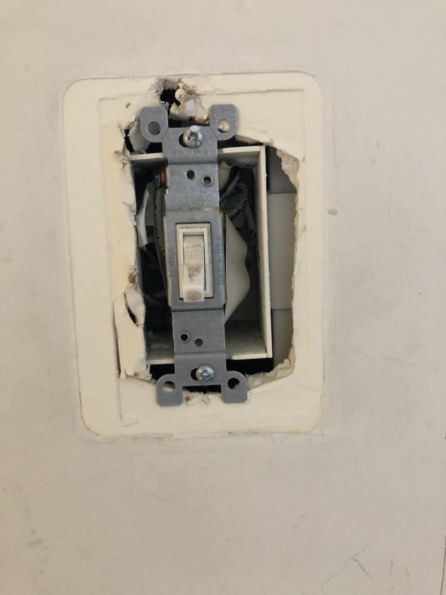
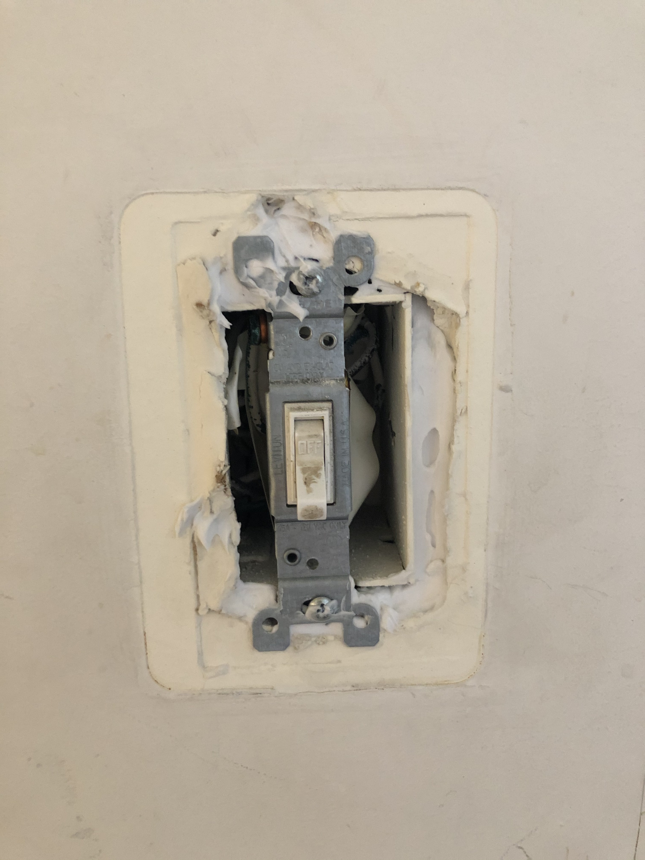

Data Collection and Analyst at EcoAction Arlington.
Noe Cuadra
Sustainable Enterprise
Background
Here is an example of a switch outlet being calked around the borders to reduce air leaks in the building.
Findings
EcoAction is a 501(C)(3) not-for-profit organization that focuses on addressing environmental issues in Arlington. The organization was founded in 1978 as a member of the Keep America Beautiful initiative. In 1990 they disaffiliated from the organization and continued to focus on making Arlington a healthier and more sustainable community. They offer programs ranging from green living, waste management, and invasive plant procedures.
They currently have one office in Arlington at the Fairlington Community Center and are expanding into Fairfax City this fall. They have received various awards in the past ranging from Virginia Energy Efficiency Leadership Award to the best small charity in the greater Washington area by the DC catalog for philanthropy.
Did you know you have to clean the bottom refrigerator coils every six months to a year? No, neither did I until I took this program. When refrigerators coils are clogged with dirt and dust, the refrigerator compressor works harder and longer, causing it to use more energy and shortening the life of the fridge. Joining the Energy Master’s program has made me more confident in making hands-on energy improvements at home. From October through November, every Thursday evening, I trained in workshops that dealt with how to educate a tenant on energy-saving practices to understanding air movement in a home and how to set up a calk gun properly. We also had county officials come and talk about community education opportunities and partnerships. After going through the foundations of the program, we used our skills and applied them to affordable housing units.
With the help of my team members, I made a pre and post questionnaire for tenants to fill out. The survey was written in a style that provided valuable information for stakeholders to look over. For example, I changed the question asking if the tenants had any insects in their home to ask if they consider buying appliances or electronics with Energy Star certification. I also added behavior questions that asked whether they're mindful of the time they spend in the shower and if they wore warmer clothe before turning on the heater. Lastly, to increase our data size, I’ve helped translate the questionnaire in Spanish.
Although my intern position was to collect and analyze, I felt that I spent most of my time educating families on how to save money on their utility bills. By being able to connect with them by speaking Spanish and by putting myself in their shoes formed a valuable and lasting impact. Some families had little knowledge of energy-saving practices, while others knew a lot about energy and water efficiencies.
After our group finished, we went around the unit with the tenant and explained the work we did. We talked about the benefits of calking around outlets and switches to the changes in faucet aerators and improvements in lighting due to the LED bulb installations—all for free.
Position
I am a senior studying Business Management and minoring in Sustainable Enterprise. I am interested in helping businesses achieve and improve their social, profits, and environmental impact. I applied for the Energy Master’s program through EcoAction as a data collection and analyst intern. I helped develop a qualitative questioner and entered data related to the populations that I served.
Acknowledgements
I heard about this program at a local farmers market, where I met Mary Sanders, the Energy Masters coordinator. She went over the program, and I was excited to start. I applied, got interviewed, and was accepted into the program. Mary was helpful and flexible with every volunteer's needs and questions. She guided us with strong leadership and offer opportunities to step up to different positions.
This chart shows the total population I served while in the program.

