Slide 1
Convocation Fall 2022
081722

Slide 2
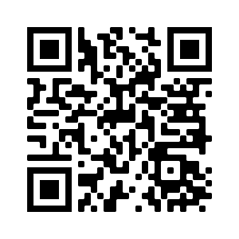
Notes:
It is wonderful to see you all!
Your parents and teachers probably told you to stay out of trouble … of the bad variety. I’m here to talk to you this morning about good trouble.

Slide 3
“To each and every one of you, especially you young people ... Go out there, speak up, speak out. Get in the way. Get in good trouble. Necessary trouble, and help redeem the soul of America.”
-John R. Lewis, congressman
& civil rights leader
Notes:
As we come together today to celebrate the start of your educational journey at Mason, it is an opportune moment to think about what Congressman and civil rights leader John Lewis meant when he urged us all to get in good trouble.
Your horizon will expand over the next few years as you are exposed to new people, ideas, and skills. But here, today with this convocation, you are also being inducted into a larger community, in which each of you play an important role.
These years can be a time for YOU to decide what are the positive social changes you would like to see in your community and what you can do to help achieve them-- whether on campus, in your hometown, or at the national and international level.

Slide 4
What does it mean to get in good trouble?
Notes:
So -- what does it mean to get in good trouble? What does it mean to you? And what does it mean for what you choose to do in your time at Mason? Notably -- you do not have to wait until you are back here for graduation to start thinking about—and acting on—the ways in which you want to make an impact.
Both in and out of the classroom, this university is a place where you can explore these questions, work with others, and make your voices heard. There is no one path --it will look different for each one of you.
For John Lewis, getting in good trouble meant voting, actively participating in democracy, and speaking out against injustice.
For me personally, the questions that inspire my research and teaching at Mason are not only how do we improve our capacity to use science to make better governance decisions about our future, but who decides what evidence is needed and what forms of knowledge count? We are experiencing a period of massive scientific, technological, and environmental change that will alter society in ways that we can only yet begin to imagine.
The decisions we make during this time could make our communities more equitable and just .. or heighten inequalities well beyond what we experience today. As science and technology increasingly pervade society, how do we democratize their creation and governance? Who is included, and who is sidelined?
Just ten days ago, President Biden signed the bipartisan CHIPS and Science Act. The law in part directs NSF to grow use-inspired, translational research and to make educational opportunities in science and technology more broadly available across the country.
Universities like Mason are at the forefront:
doing research differently – breaking down academic silos to work across the natural and social sciences and partner directly with communities and decision-makers to address questions of societal consequence;
and teaching differently to ensure all students develop the skills to not just create new knowledge, but do it in collaboration with people who have different values, lived experiences, and ways of knowing.

Slide 5
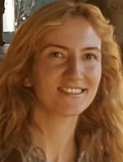
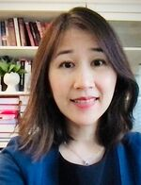
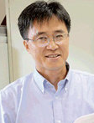
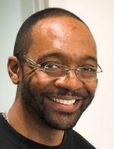
Mason faculty support you
Asst Prof Ben Manski
Asst Prof Yasemin Ipek
Assoc Prof Gabrielle Tayac
Assoc Prof
Cher Weixia Chen
Assoc Prof Dae Young Kim
Assoc Prof
Richard T Craig
Notes:
We want to support YOU in getting into good trouble and in creating positive social change. This fall, Mason’s Office of Community Engagement and Civic Learning (CECIL) and these faculty will pilot monthly hour-long community conversation circles over pizza.
Each of these professors at Mason thinks a bit differently about what it means to get into good trouble, and they are here to help you figure out your own path. Use the QR code to learn more about each one.

Slide 6
Join us this fall
https://cecil.gmu.edu/students/good-trouble
Notes:
Join us – faculty and your fellow students -- this fall to talk “Good Trouble.” We would love to see you in September!

