Slide 1
Marching Orders – Continued

Slide 2
Khader Abdi
Master of Science, Computational Science
College of Science

Slide 3
Alexander Agaev
Master of Science, Forensic Science
College of Science

Slide 4
Dina Ajalli
Master of Science, Biology
College of Science

Slide 5
Katherine Grace Aliotta
Master of Science, Chemistry
College of Science

Slide 6
Zohoor Ahmed N Alodhaibi
Bachelor of Science, Medical Laboratory Science
College of Science

Slide 7
Lily Appiah
Bachelor of Science, Biology
College of Science

Slide 8
Swetha Arabandi
Bachelor of Science, Biology
College of Science

Slide 9
Hunfa Asghar
Master of Science, Biology
College of Science

Slide 10
Kelly Melissa Beltre
Master of Science, Forensic Science
College of Science

Slide 11
Lauren Billups
Bachelor of Science, Neuroscience
College of Science

Slide 12
Esprit N. Blatchford-Rodriguez
Bachelor of Science, Neuroscience
College of Science

Slide 13
Jason Dale Boarts
Master of Science, Forensic Science
College of Science

Slide 14
Bryce R Bossuot
Bachelor of Science, Environmental Science
College of Science

Slide 15
Emily Ann Brown
Master of Science, Forensic Science
College of Science

Slide 16
Gustavo Castro
Bachelor of Science, Biology
College of Science

Slide 17
Damian James Cavanagh
Master of Science, Biology
College of Science

Slide 18
Amy Nicole Cheang
Bachelor of Science, Medical Laboratory Science
College of Science

Slide 19
Joshua H Cho
Bachelor of Science, Computational & Data Sciences
College of Science

Slide 20
Chadrick Tyler Cole
Bachelor of Science, Chemistry
College of Science

Slide 21
Jessica L Collins
Master of Science, Environmental Science & Policy
College of Science

Slide 22
Milady T Delacruz
Bachelor of Science, Forensic Science
College of Science

Slide 23
Cameron David Dow
Bachelor of Science, Environmental Science
College of Science

Slide 24
Austin Robert Dykes
Bachelor of Science, Geography
College of Science

Slide 25
Emily Elizabeth Engdahl
Bachelor of Science, Environmental Science
College of Science

Slide 26
Jorge Eduardo Fishtahler
Bachelor of Science, Geography
College of Science

Slide 27
Camille M Flores
Master of Science, Forensic Science
College of Science

Slide 28
Ryan J Frayne
Master of Science, Geographic & Cartographic Sciences
College of Science

Slide 29
Prakash Gautam
Bachelor of Science, Geography
College of Science

Slide 30
Rosemary L Hall
Bachelor of Science, Chemistry
College of Science

Slide 31
Ryan Christopher Hammond
Bachelor of Science, Neuroscience
College of Science

Slide 32
Brittany Nicole Heath
Master of Science, Biology
College of Science

Slide 33
Collin C Henley
Bachelor of Science, Computational & Data Sciences
College of Science

Slide 34
Ilia Houman
Bachelor of Science, Mathematics
College of Science

Slide 35
Rachel L Jackson
Bachelor of Arts, Geology
College of Science

Slide 36
Matthew E James
Master of Science, Forensic Science
College of Science

Slide 37
Misbah Iram Jarral
Bachelor of Arts, Mathematics
College of Science

Slide 38
Sean T Jones
Bachelor of Science, Atmospheric Sciences
College of Science

Slide 39
Helal A Kakar
Bachelor of Science, Biology
College of Science

Slide 40
Anna Kapp
Bachelor of Science, Chemistry
College of Science

Slide 41
Harneet Kaur
Bachelor of Science, Biology
College of Science

Slide 42
Mia Keady
Master of Science, Biology
College of Science

Slide 43
Alexander K Kirkov
Bachelor of Science, Biology
College of Science

Slide 44
Matthew Kutyna
Master of Science, Biology
College of Science

Slide 45
Sarah Nanaa Laryea
Bachelor of Science, Medical Laboratory Science
College of Science

Slide 46
Bryan LeBlanc
Master of Science, Geographic & Cartographic Sciences
College of Science

Slide 47
Su Ah Lee
Bachelor of Science, Computational & Data Sciences
College of Science

Slide 48
William Jordan Lominac
Bachelor of Science, Chemistry
College of Science

Slide 49
Kim V Mai
Bachelor of Science, Biology
College of Science

Slide 50
Brian Paul Marshall
Master of Science, Forensic Science
College of Science

Slide 51
Mechelle C McCoy
Master of Science, Forensic Science
College of Science

Slide 52
Tyler M McDaniel
Bachelor of Science, Environmental Science
College of Science

Slide 53
Paul J McDonald
Master of Science, Forensic Science
College of Science

Slide 54
Liam David McKenna
Bachelor of Science, Computational & Data Sciences
College of Science

Slide 55
Anthony Michael
Master of Science, Chemistry
College of Science

Slide 56
Symone Moore
Master of Science, Environmental Science & Policy
College of Science

Slide 57
Alexander Morres
Master of Science, Mathematics
College of Science

Slide 58
Grant A Murray-Hiteshew
Bachelor of Science, Environmental Science
College of Science

Slide 59
Scott Negin
Bachelor of Science, Geography
College of Science

Slide 60
Benjamin Nolen
Bachelor of Science, Environmental Science
College of Science

Slide 61
Maha Noor
Bachelor of Science, Neuroscience
College of Science

Slide 62
Farhat Noory
Bachelor of Science, Biology
College of Science

Slide 63
Casey M Pehrson
Master of Science, Environmental Science & Policy
College of Science

Slide 64
Apoorva Raj Pendurthi
Bachelor of Science, Neuroscience
College of Science

Slide 65
Jamesha N Pope
Bachelor of Science, Neuroscience
College of Science

Slide 66
Najiyah A Prome
Bachelor of Science, Biology
College of Science

Slide 67
Ramesha Rai
Bachelor of Science, Neuroscience
College of Science

Slide 68
Hamza Rashid
Bachelor of Science, Biology
College of Science

Slide 69
Pavan Gunna Reddy
Bachelor of Science, Neuroscience
College of Science

Slide 70
Melissa Guadalupe Rodriguez
Bachelor of Science, Biology
College of Science

Slide 71
Veronica G Sanchez
Bachelor of Science, Chemistry
College of Science

Slide 72
Telly Sepahpour
Master of Science, Biology
College of Science

Slide 73
Sai Anukhya Singh
Bachelor of Science, Neuroscience
College of Science

Slide 74
Michael James Sommar
Master of Science, Geographic & Cartographic Sciences
College of Science

Slide 75
Illia Stadnyk
Bachelor of Science, Mathematics
College of Science

Slide 76
Nicholas J Stearns
Bachelor of Science, Biology
College of Science

Slide 77
Medina H Taher
Bachelor of Science, Biology
College of Science

Slide 78
Domenic Anthony Tommarello
Master of Science, Biology
College of Science

Slide 79
Trangdai Thi Tran
Master of Science, Forensic Science
College of Science

Slide 80
Davaasuren Tsogtbayar
Bachelor of Science, Biology
College of Science

Slide 81
Sarah Emily Tuomey
Bachelor of Science, Chemistry
College of Science

Slide 82
Keanah Turner
Master of Science, Environmental Science & Policy
College of Science

Slide 83
Monica R Vidaurri
Bachelor of Arts, Biology
College of Science

Slide 84
Emily Dinsmoor Vorek
Master of Science, Environmental Science & Policy
College of Science

Slide 85
Cody A Waisanen
Master of Science, Biology
College of Science

Slide 86
Hannah Marie Warnick
Bachelor of Arts, Mathematics
College of Science

Slide 87
Blake Matthew Weber
Bachelor of Science, Biology
College of Science

Slide 88
Rachael Mae White
Bachelor of Arts, Mathematics
College of Science

Slide 89
Holly M Wilkes
Master of Science, Forensic Science
College of Science

Slide 90
Georgia Alexandrea Williams
Master of Science, Forensic Science
College of Science

Slide 91
Benjamin Kaplan Wolfenstein
Master of Science, Geographic & Cartographic Sciences
College of Science

Slide 92
Kimberley Yee
Bachelor of Science, Medical Laboratory Science
College of Science

Slide 93
Suha T Zelawar
Bachelor of Science, Biology
College of Science

Slide 94
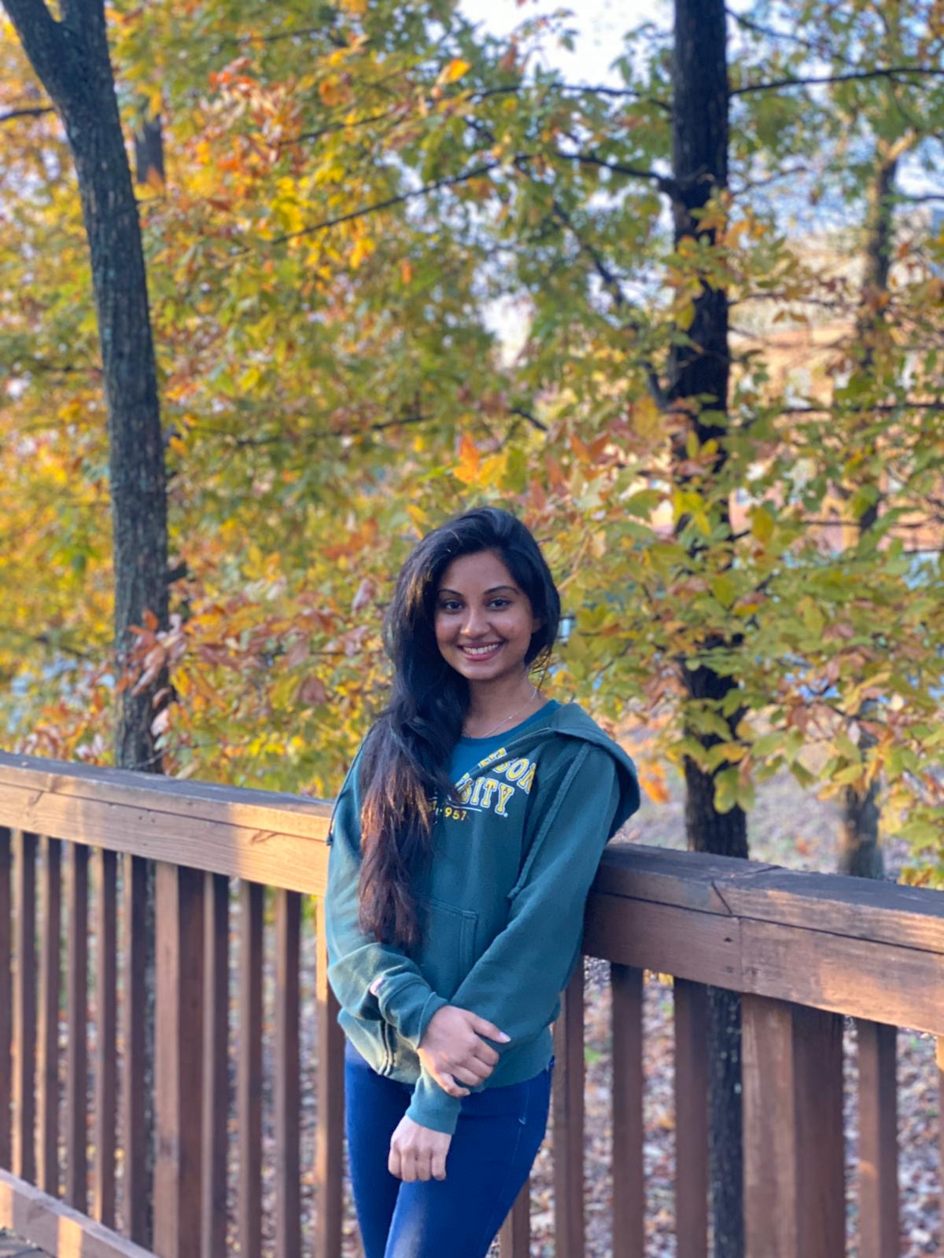
Chamodya Ruhunusiri
Post Baccalaureate Graduate Certificate – Personalized Medicine
College of Science
Got through this unique semester! It has been a beautiful journey, and I am very thankful for my parents, teachers, friends and GMU for everything!

