Slide 1

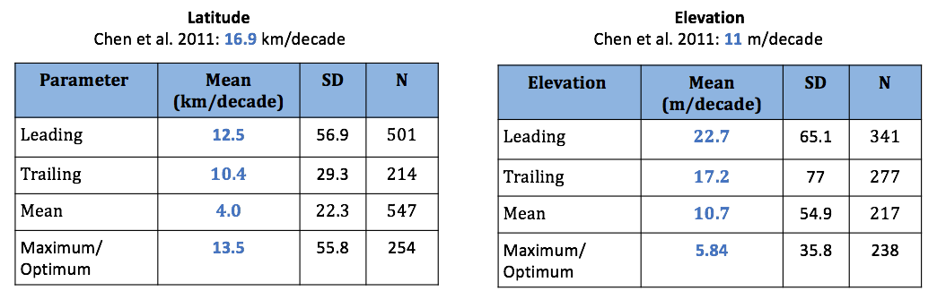
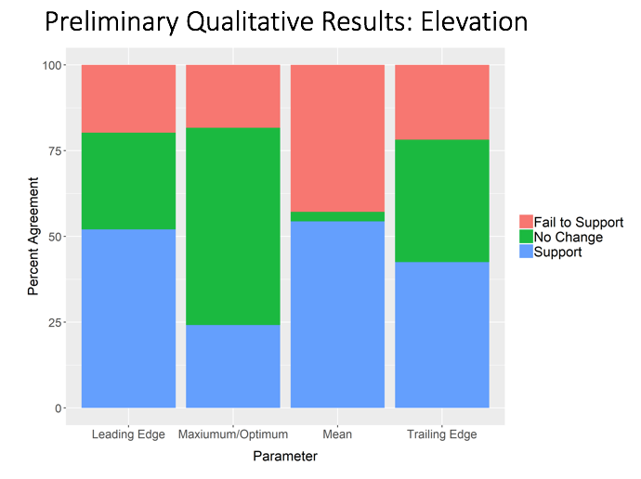
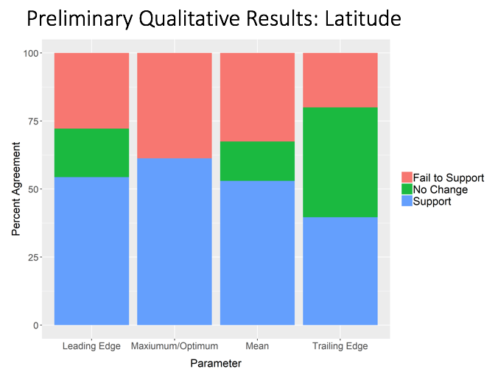

Synthesis of Species’ Range Shifts in Response
to Climate Change.
Ciara Johnson
B.S. Environmental Science
Background
Findings
My internship took place at National Climate Adaptation Science Center (NCASC). The eight Climate Adaptation Science Centers (CASCs) around the country were established by Congress in 2008. The National CASC (NCASC) is the national office, located in Reston, VA in the U.S. Geological Survey headquarters. The mission of the CASCs is to deliver science to help fish, wildlife, water, land, and people adapt to a changing climate.
I worked on the Biodiversity Impacts Framework (BIF) project, specifically on the Synthesis of Species’ Range Shifts in Response to Climate Change. It is hypothesized that in response to rising temperatures, species will shift their ranges to higher latitudes and elevations. In response to changing precipitation patterns, species will shift to stay within their preferred precipitation levels.
The preliminary results include only 39 papers’ data. Overall, the mean shift in elevation and latitude support the hypothesis, as well as agree with previous seminal papers regarding species range shifts.
Chen et al’s paper in 2011 recorded species ranges shift on average 16.9 km per decade. Our results report that on average, species ranges shifted higher in latitude 4 km per decade, and higher in elevation by 10.7 km/decade (Figure 1). No shift was negative, further supporting our hypothesis. Qualitatively, less than 25% of range shifts fail to support the hypothesis, meaning they moved lower in latitude or elevation (Figures 2 and 3). Possible explanations include failure to adapt or move fast enough in response to climate change. Some species showed no change in range, indicating their possible ability to adapt instead of shift geographically. Approximately 50% of species support our hypothesis by shifting upwards. No conclusions can be drawn from such early data, however there is hope that most data will support our hypothesis.
There was some disparity in the data collected. Often, range shifts were recorded in different measurements than kilometers per decade. Scientists should present more uniform data to allow biodiversity responses to be analyzed world wide. There is also a lack of reptile and amphibian data, indicating a potential research gap to be filled.
The next step for BIF is a vulnerability assessment, in hopes of explaining why some species failed to move, or moved in the opposite direction. Variables such as adaptive capacity, sensitivity, and exposure will be analyzed.
Figure 1. Mean movement of all species in kilometers per decade, both in latitude and elevation.
Position
My task involved reading through over 3,000 article abstracts, which were retrieved from a search with specific search terms. Articles that met our criteria (must display a range shift in relation to temperature or precipitation) were marked as ”pass”. In total, 292 articles passed our initial search. Next, I assisted with reading through the articles in full, and entered basic variables into a large matrix in google sheets. Information included species name, kilometers per decade shifted, and whether or not the shift agreed with our hypothesis.
I was able to attend weekly staff meetings along with other interns and scientists of the CASCs. I travelled to Shepherdstown, WV to the National Conservation training center to meet with other scientists across the nation involved in the BIF project.
Background knowledge in ecology is helpful, as well as experience reading scientific papers. Basic skills in R programming language would usher a better understanding of the statistical analyses used.
Figure 2. Percent agreement of elevational changes in relation to the hypothesis
Figure 3. Percent agreement of latitudinal changes in relation to the hypothesis
Acknowledgements
U.S. Geological Survey
National Climate Adaptation Science Center
Thank you to Shawn Carter, head of the NCASC, my mentors Madeleine Rubenstein, Biologist and Sarah Weiskopf, Biologist, as well as my fellow intern Mari Rodriguez for allowing be to be a part of the BIF project.

